Slide 1
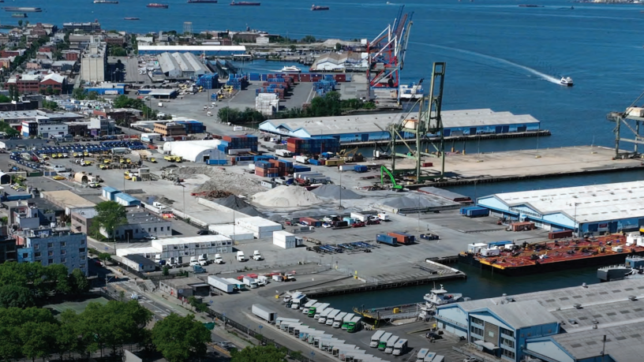
Preparing for BMT Scoping Hearing

Slide 2
What is Environmental Review?
City Environmental Quality Review (CEQR) law requires city agencies to analyze the potential environmental impacts of any rezoning action.
The “environmental impact” is the potential effect of the new development and population on aspects of neighborhood life such as:
  Socioeconomic conditions – the existing population and businesses in the neighborhood
  Community facilities such as schools and child care
  Open Space and shadows
  Transportation (both traffic and public transit)
  Water and sewer infrastructure
  Hazardous materials and air quality
  Historic resources and neighborhood character

Slide 3
What is Environmental Review?
Environmental Review Steps:
    The “Environmental Assessment Statement” (EAS) defines the “Reasonable Worst Case Development Scenario” (RWCDS) – a conservative projection of the new development that may occur pursuant to a discretionary action (i.e., zoning map change, special permit, etc.)
    If this projection meets or exceeds the threshold and its likely impacts are determined to be significant through the CEQR process, a full Environmental Impact Statement (EIS) is required.
    The “Draft Scope of Work” outlines what will be studied in the EIS, to give the public, elected officials and agencies a chance to review and comment on the proposed methodology and scope before the EIS is written.
        The City must hold a “Scoping Hearing” to allow the public to comment on the Draft Scope of Work
        The Final Scope of Work incorporates agency responses to comments.
    The “Draft Environmental Impact Statement” (DEIS) is issued before the public review process starts and further comments can be made at the CPC public hearing
    The “Final Environmental Impact Statement” (FEIS) is issued before the CPC vote; all substantive comments must be addressed in writing

Slide 4
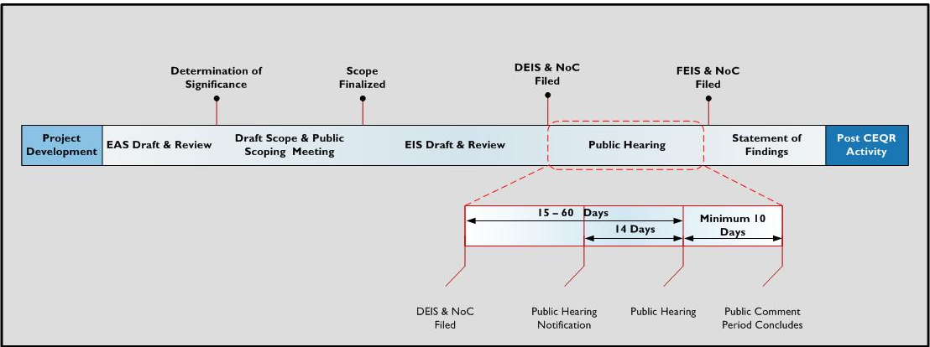
The Environmental Review Process

Slide 5
What is Scope?
The “scope” of the environmental analysis refers to:
1. The list of topics to be studied and the methodology by which to study them
      The CEQR Technical Manual sets the usual standards but special circumstances may warrant more detail or additional study
2. The range of development proposals to be analyzed:
        Any changes in zoning, such as the allowed density or uses, must be analyzed for their potential effects.
        The “scope” of analysis covers the range from the existing condition to the proposed condition.
            For example, if project's environmental review analyzes 20-story buildings with 3,000 apartments where no housing is currently allowed, later increasing the project to 40-story buildings with 6,000 apartments would be "out of scope"
              However, later reducing to 15-story buildings with 2,000 units would be in-scope
            Similarly, later adding a totally different use like an arena would also be out-of-scope

Slide 6
Why is a Scoping Hearing Important?
Defines what gets studied (helps determine which environmental issues should be analyzed in the EIS)
Ensures that the right questions are asked early in the process, prior to the technical work being done
Offers the opportunity to ask for alternatives (e.g., alternative development proposals) to be analyzed so that they are in scope for future modifications to the proposal
Builds transparency and accountability by ensuring the process is open, documented and responsive to public and stakeholder concerns

Slide 7
BMT: Reasonable Worst Case Development Scenario (RWCDS)
Envisions redevelopment into a 60-acre, modern, sustainable all-electric port
Includes ~6,000 dwelling units, with ~2,400 (40%) permanently affordable
Provides ~275,000 sq ft of light-industrial space
Adds ~250,000 sq ft of community facility uses
Includes ~275,000 sq ft of commercial space
Incorporates ~155,000 sq ft of hotel space
Creates ~28 acres of new destination and neighborhood open space
Reflects the 9/22/25 approved BMT Vision Plan

Slide 8
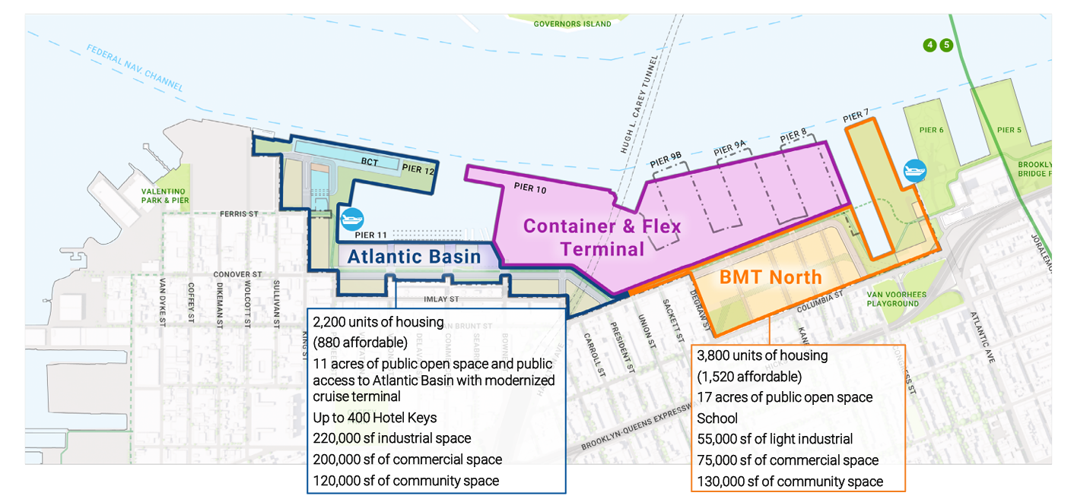

Slide 9
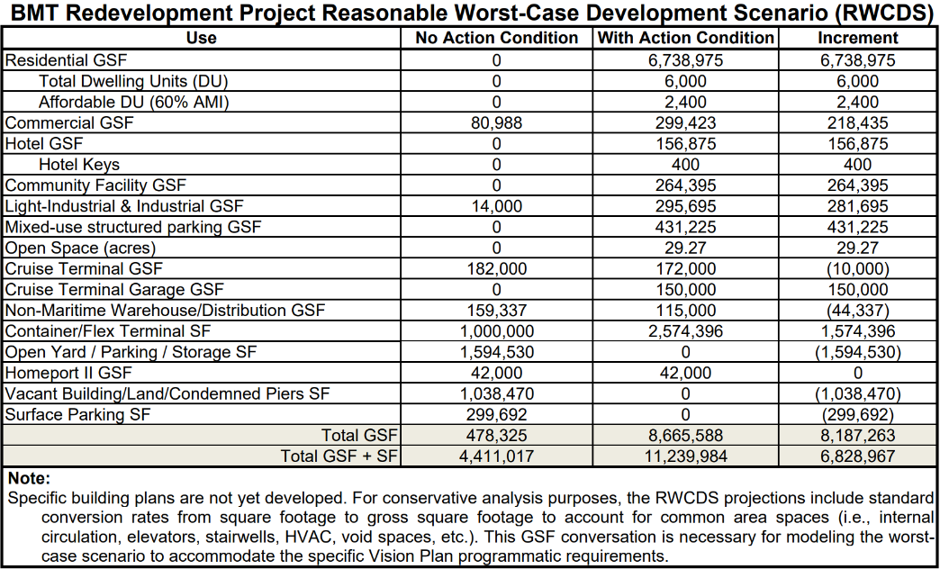
Reasonable Worst Case Development Scenario (RWCDS)

Slide 10
Examples of Environmental Review Comments and Concerns
for BMT at Scoping
Policy impact of residential use introduced in a Significant Maritime Industrial Area
Potential impact on the city's overall maritime freight capability due to shrinking port
Ensuring the Terminal remains an active industrial use
Lack of infrastructure to support added residential density – especially water/sewer
Increased vehicular traffic in area with mostly narrow streets
Relationship to and cumulative impacts of the BQE Triple Cantilever project
Lack of accessible public transit
Indirect displacement pressure on industrial businesses and affordable residential apartments
Environmental impacts in a flood prone area

