Slide 1
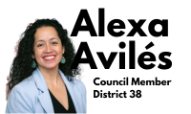
LAST MILE AND ZONING FOR
ECONOMIC OPPORTUNITY
Council Member Alexa Avilés and
The Last Mile Coalition
NOTE: This is a public awareness document and does not constitute an endorsement of any of the text amendments included in City of Yes.
Notes:
(Council Member Intro: Slide 1)
Thank you for joining today for what I hope is a brief but impactful session on how Last Mile continues to wreak havoc on environmental justice communities, such as the one I represent, and the opportunity we are presented with through our vote on Zoning for Economic Opportunity.
Before diving in, I want to thank members of the land use team, including Brian Paul, William Vidal, and Perris Straughter. I also want to thank members of the Last Mile Coalition, some of whom are with us today, for being our partner on this since day one, including NYC-EJA, UPROSE, The Point, NYLPI, and Earthjustice.
I just want to quickly hand it over to Kevin Garcia of NYC-EJA for a brief introduction before getting into the material….
(Kevin Intro)
Started in 2021 with Red Hook and Sunset Park
Looked citywide
No review; want to make sure they’re being good neighbors

Slide 2
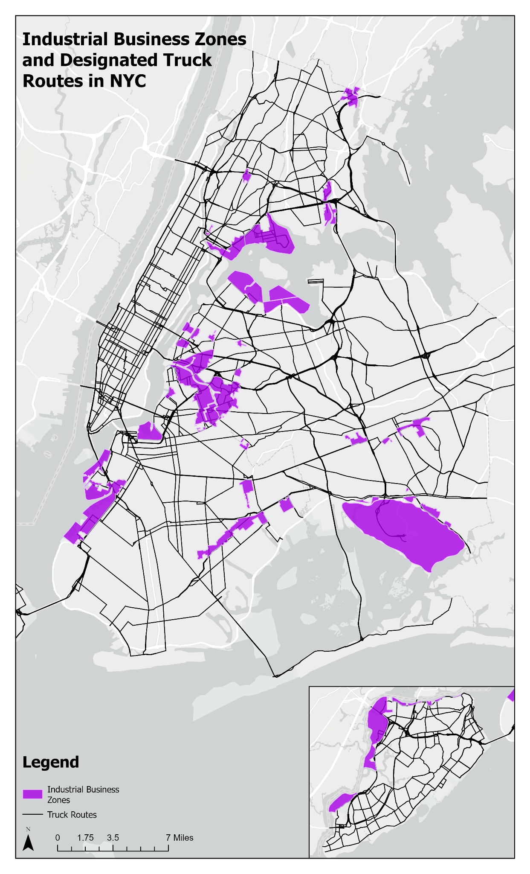
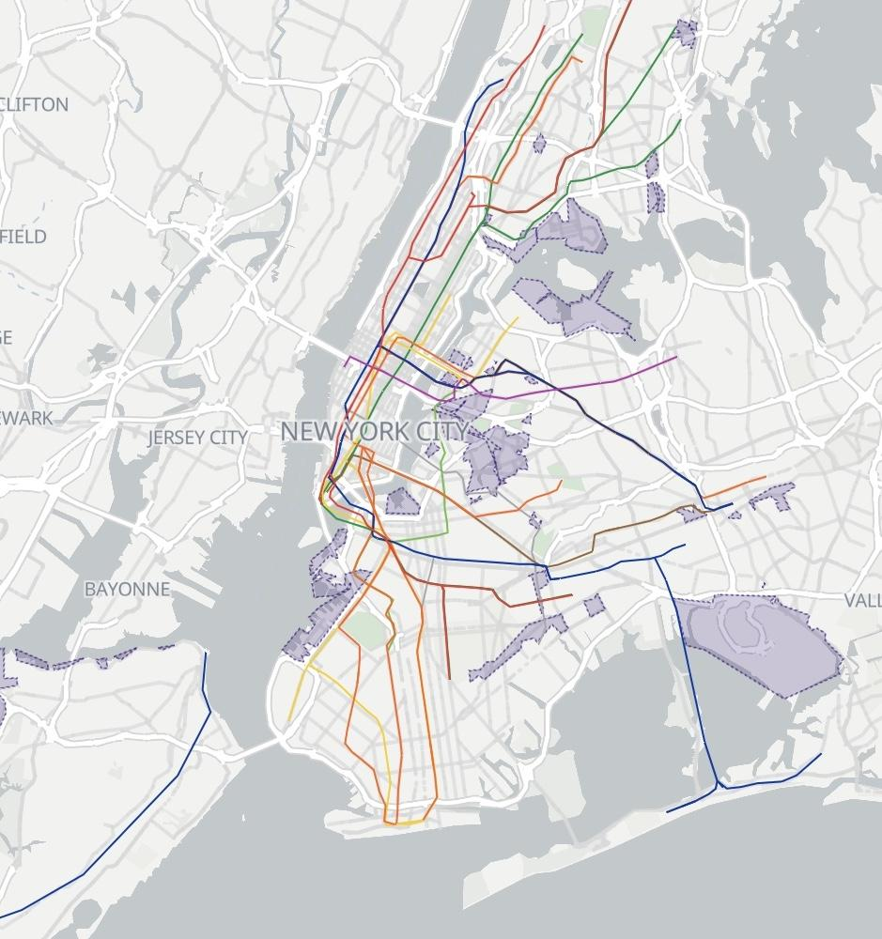
Current IBZ Map
Notes:
(Amarachi Slide 10)
Here, we are reminding you of what we covered at the top. If you represent the areas shaded in purple, if you represent an EJ community, if you are concerned with air quality and traffic congestions, and if you want our industrial zones to remain vibrant zones for expanded opportunity, I encourage you to join us in coalition in our ask for urgent action from DCP.

Slide 3
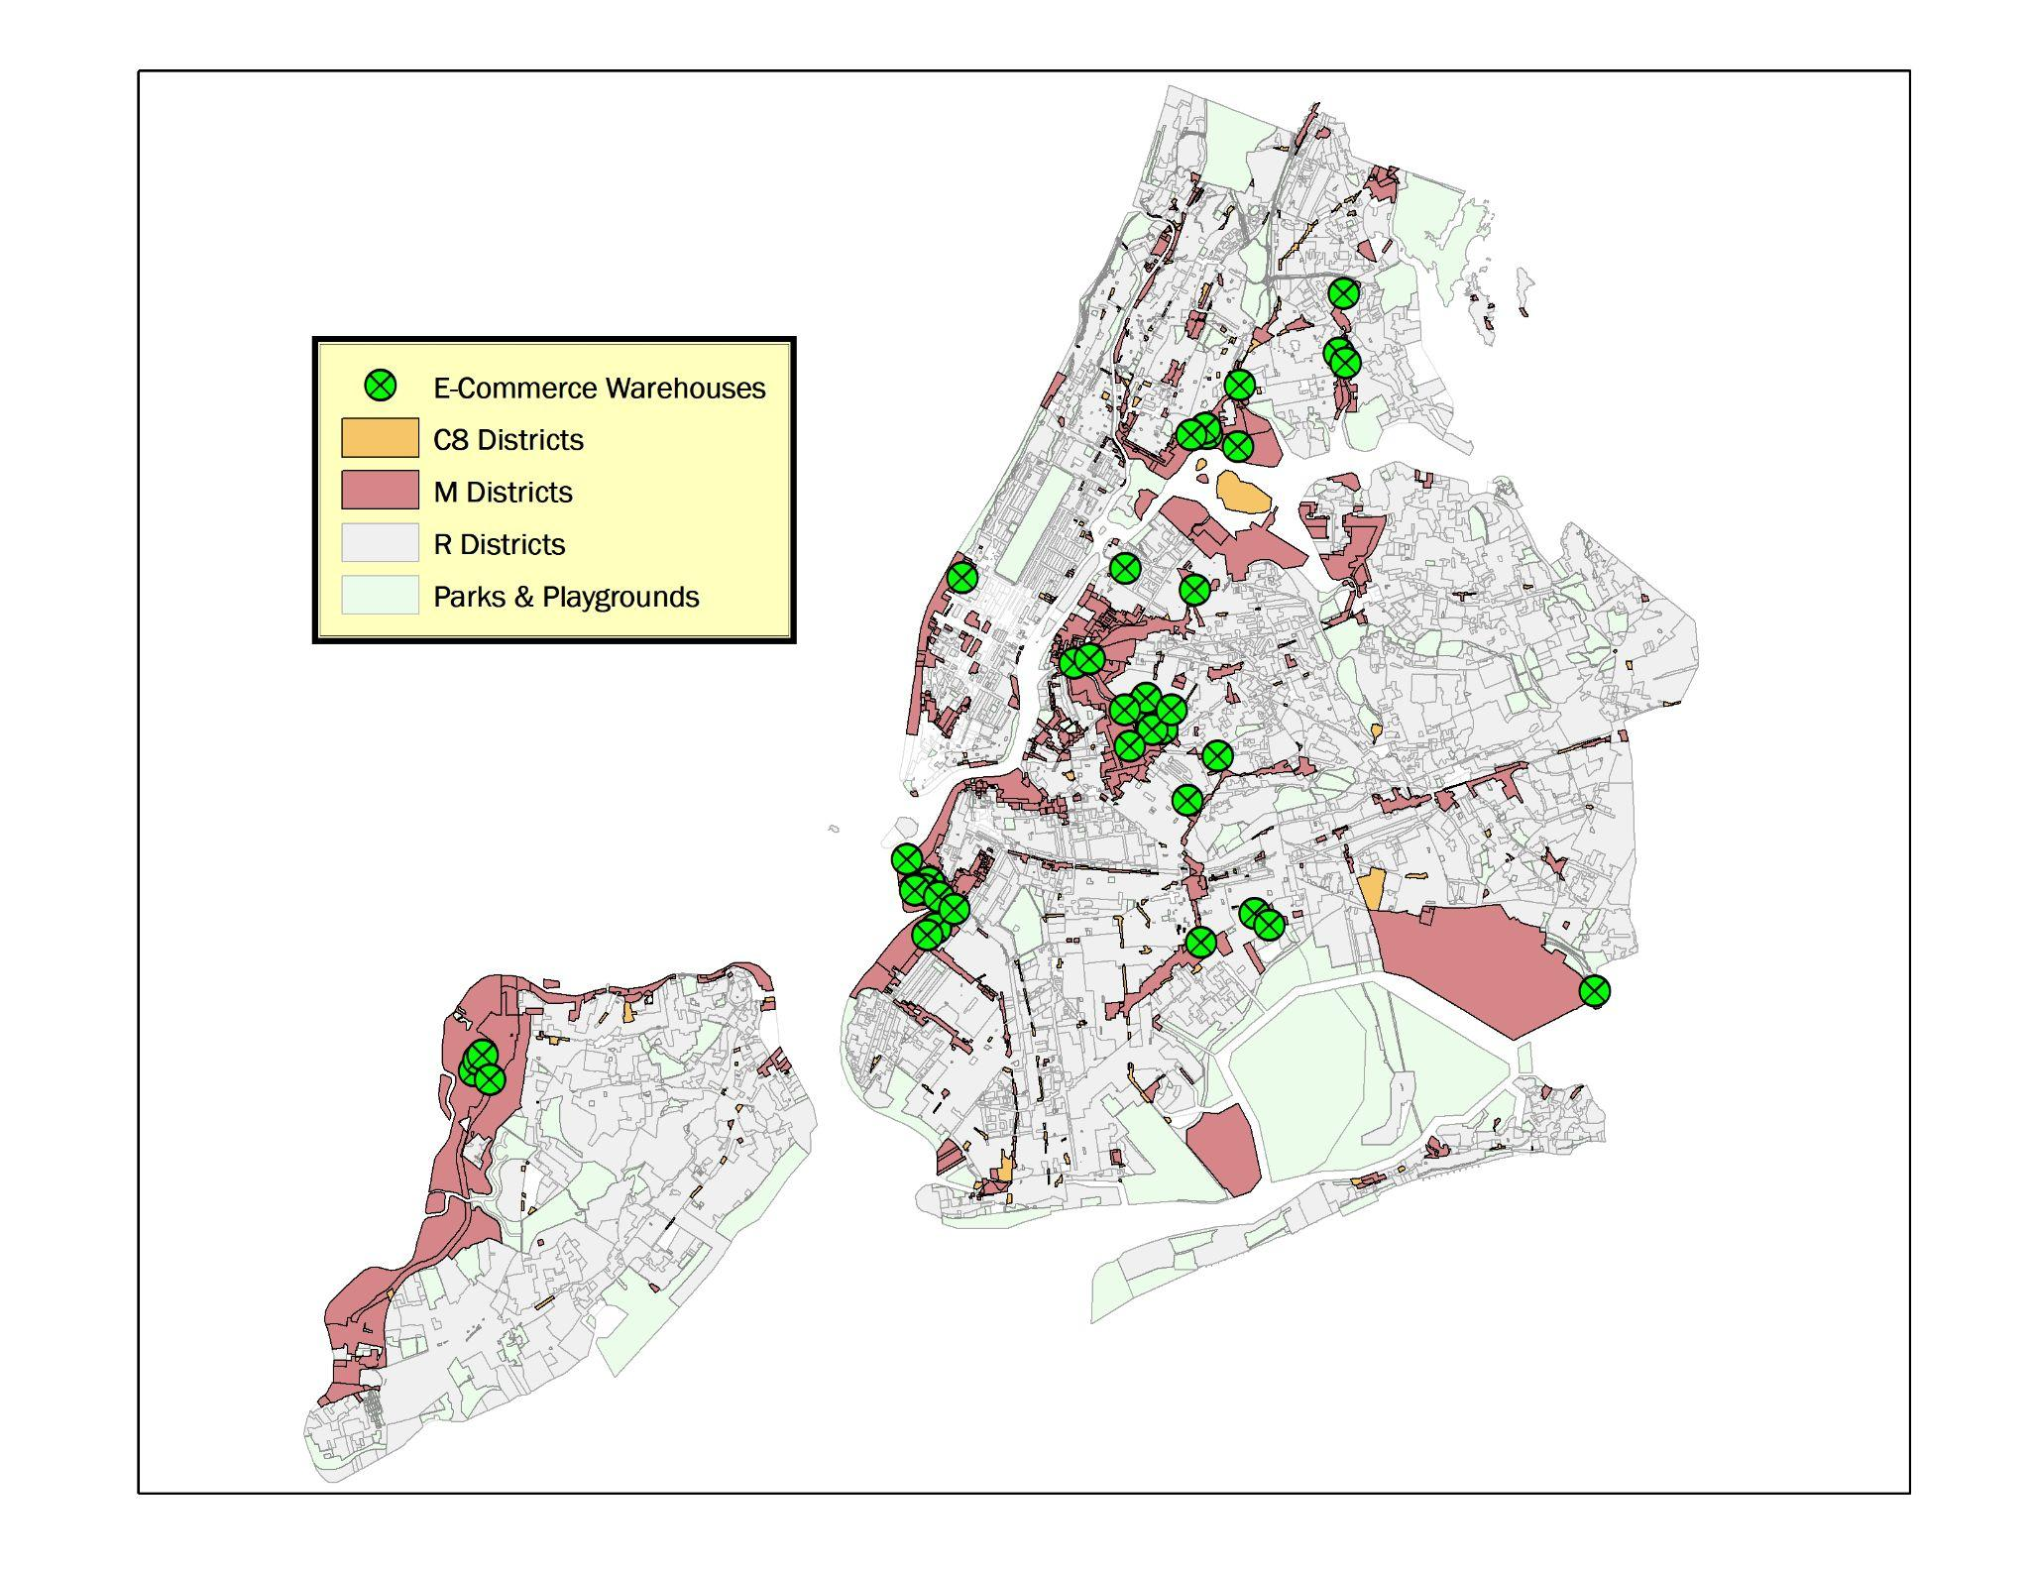
Snapshot | Citywide
Brooklyn: Brooklyn Navy Yard, East New York, Flatlands-Fairfield, Greenpoint-Williamsburg, North Brooklyn, Southwest Brooklyn
Bronx: Bathgate, Eastchester, Hunts Point, Port Morris, Zerega
Queens: Jamaica, JFK Industrial Corridor, Long Island City, Maspeth,. Ridgeway/SoMA, Steinway, Woodside
Staten Island: North Shore, Rossville, West Shore
Notes:
(Coalition Slide 5):
Here, you’ll see a citywide map. To the side, we’ve noted the various IBZs as this is where the facilities are popping up.
Note that it’s hard to map these facilities precisely because there is no definition [or public database], so this represents our best effort at looking at information from various sources including community members, media, and truck traffic to name a few
If you recognize a green dot in your neighborhood, let us know in the chat

Slide 4
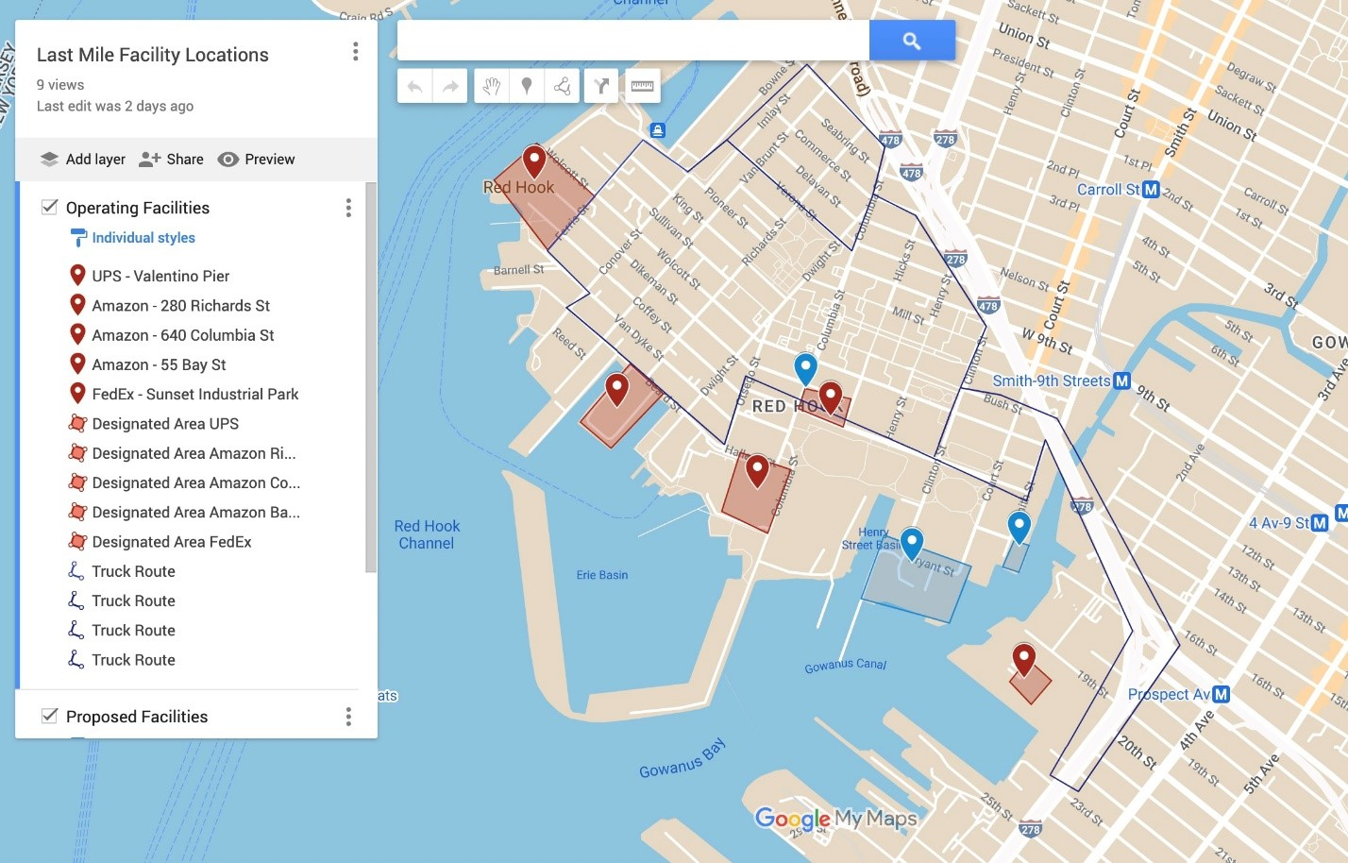
Snapshot | D38 Last Mile Facilities
Amazon – 640 Columbia St – approximately 400,000sf
Amazon – 280 Richards St – approximately 320,000sf
UPS – Valentino Pier – 1,200,000sf
Buckeye Terminal/RXR (development in progress) – Court Street – 850,000sf
659 Smith St – proposed – 168,000sf
Amazon - 55 Bay Street – 90,000sf
Dov Hertz - 537-555 Columbia St – 88,000sf
Sunset Industrial Park/FedEx – 690,000sf
With more planned…
Notes:
(Christina Slide 4):
Just as a point of reference, this is what we are dealing with in District 38, and this isn’t even the full scope of it. It feels like each day we hear of potential for yet another facility.
You’ll see here, this is already millions of square feet of short term storage - estimated to generate approximately another 3,000 trucks or more in and out of our neighborhoods each day
We currently have no tools in our toolbox to prevent this clustering from happening in our district, or regulate the existing facilities to prevent greater harm to our communities
With ecommerce and logistics being the top growth industry locally and nationally, we are likely to see further proliferation in the absence of regulation.

Slide 5
District 38 is an Impacted Community
Our IBZ has a proliferation of Last Mile facilities, leading to:
Homogeneity in services when usage of these spaces should reflect our city’s diverse manufacturing needs
Limited access and use of critical waterfront
Limited availability of job type and opportunity
The proliferation of these facilities has meant:
Additional traffic congestion in our district since our community is located along the existing NYC truck route
Increased exhaust and particulate matter
Notes:
(Council Member Slide 2):
We Represent Impacted Communities
Most of these facilities are concentrated in the IBZ - we will show some illustrative slides later on - but if you represent an IBZ, which is likely already an Environmental Justice community, you have probably observed these facilities grow their footprint exponentially in your district.
Even if you don’t represent an IBZ, you might be concerned because your community is situated along a truck route. You might also be concerned about the proliferation of last mile if you care about traffic congestion on our city streets, pollution levels, opportunities to grow industry in our city, waterfront access, or good family sustaining jobs, Last Mile is a concern for you

Slide 6
THE PROBLEM
Due to antiquated zoning laws, which DCP attempts to address through City of Yes, Last Mile facilities are characterized as traditional warehouses even though the operations of last mile facilities are dramatically different from traditional warehouses.
This makes it hard for us to identify and address their full impact.
Notes:
(Coalition Slide 3):
While the ZEO attempts to address antiquated zoning laws, it has ignored an outdated definition of “warehouse,” which has allowed for last mile facilities to be developed as though they are a warehouse, even though they are fundamentally different.
A traditional warehouse, and the one for which the definition was established back in the 1960s, is generally for long-term storage of goods delivered to the facility in bulk, and distributed in bulk over large geographic zones, often with less truck traffic. Last Mile distribution prioritizes short term storage of goods for distribution within a small geographic zone through a massive uptick in delivery vehicles to and from the facility.
As a result of this very loose definition, we have seen a rampant increase in last mile facilities, concentrated in low income communities of color.
This lack of definition has resulted in representatives, advocates, and community members being unable to address the full impact of these facilities.

Slide 7
NEED FOR REGULATION
Poor health and living conditions | A disproportionate placement and concentration of these facilities continues to occur in communities of color and low-income communities resulting in
Increased noise pollution – resulting in sleep disturbance, and lower mental health outcomes overall.
Increased traffic and congestion caused by delivery vehicles, resulting in higher risk and incidence of injury and death.
Increased air pollution
With an established link between exposure to nitrogen oxides and the development of disorders such as anxiety and depression in children.
Higher asthma rates.
Restricting opportunities
Proliferation of low paying jobs.
Creating a homogenous IBZ
Limiting opportunities for the city to develop climate oriented delivery solutions, such as water freight.
Notes:
(Slide 6)
(Coalition)
The consequences of having an over saturation of these facilities in any given community are many, and can roughly be broken down into two categories.
Starting with poor health and living conditions
We have increased noise pollution, increased traffic congestions, and increased air pollution
(Council Member)
We also have real consequences from a planning perspective, which includes
the availability of only one type of job, often low-paying
When amazon and the like buy up huge portions of our industrial space, it limits opportunities for smaller scale manufacturers to call our neighborhoods home. In my district, I am proud to be the home for a yogurt producer, a manufacturer of optical frames, and more. These opportunities for small-mid size manufacturing become less and less the more land giant corporations are able to buy and develop “as of right.” It also, quite frankly, is boring, and robs our communities of vibrancy and culture
Last but not least, these facilities restrict our opportunities to meet our stated climate goals. In my district, we have a giant facility on the waterfront that has not invested in waterfront infrastructure, and does not make use of the waterfront at all. This land is now no longer available to help develop the blue highway, which would help get trucks off the roads in our neighborhoods

Slide 8
OUR OPPORTUNITY
Passage of the ZEO in April presents an opportunity: regulation of Last Mile facilities.
Afterall, ZEO already lays out rationale for micro-distribution.
Notes:
Alok (Coalition Slide 7):
We are presented with a unique opportunity. City planning rarely undertakes citywide zoning changes, and at this moment, they need the Council’s vote to accomplish their goals. We ought to leverage this moment to achieve long-sought cooperation from DCP on the issue of last mile
In ZEO, DCP has identified the rise of e-commerce as one of the key macroeconomic trends that necessitates the zoning overhaul. The proposal seeks to support new and emerging industries that could support New York City’s economic recovery, like small-scale manufacturing, urban agriculture, and others, while minimizing the impact of other industries, like package deliveries, on other land uses in the City. While the ZEO addresses “Micro-Distribution” facilities as an effort to address some of the visible externalities that all New Yorkers face with the rise of e-commerce - specifically the “increased truck traffic and congestion,” it fails to capture larger facilities.
Unfortunately, DCP’s current proposal misses a key aspect of the e-commerce boom: it does not address the land use conflicts from the clustering of last-mile mega-facilities. Without any attempt to address perhaps the most obvious physical manifestation of the shift to e-commerce, DCP’s proposal is incomplete at best, and we, in coalition with all of you, want to make clear that we need urgent action on this issue in our communities.

Slide 9
DEMANDS FOR DCP
Define last mile facilities in zoning to effectively plan for this relatively new type of facility and the impacts they are having on our communities.
Engage impacted communities and advocates within 6 months of vote
Restrict the over-concentration of last-mile facilities through use of innovative tools, which may include a special permit.
Engage impacted communities and advocates within 6 months of vote.
Suite of tools developed for consideration before the end of 2025.
Limit truck and delivery related traffic and mitigate pollution impacts, thereby improving air quality and pedestrian safety.
Final proposed set of regulations presented to impacted communities by the end of 2024
Create industrial waterfront zoning provisions that compel investments and/or preservation of maritime freight access in line with parallel city goals and plans.
Notes:
(Council Member Slide 8)
As you know, defining last mile is a critical step in making both zoning and legislative advances. DCP should engage in conversation with impacted communities and advocates as a first step within six months of the ZEO vote.
Restrict the over-concentration of last-mile facilities through use of innovative tools, which may include a special permit. Similar to our first objective, we would like to see engagement with impacted communities and advocates happen within six months of the ZEO vote, with a suite of tools developed for consideration before the end of 2025.
Limit truck and delivery traffic and mitigate pollution impacts, thereby increasing air quality and pedestrian safety. Mitigation efforts may include, but are not limited to, the encouragement of alternative modes of transportation, including electric vehicles, rail and bikes for delivery to and from the facility, and may employ tools that include, but are not limited to, curb cuts, loading regulations, and operating hours provisions in a special permit. These potential tools already exist; we just need to put them into effect.. A final proposed set of regulations should be presented to impacted communities by the end of 2024 to avoid any further losses in community health.
Create industrial waterfront zoning provisions that compel investments and/or preservation of maritime freight access in line with parallel city goals and plans. This may include the development of additional zoning tools in the forthcoming citywide Industrial Development Strategic Plan, and/or during future rezonings of particular IBZs to create more customized tools.
During a time of economic transition, it is critical that we prevent private interest from occupying waterfront land in the IBZ without supporting maritime freight, a critical resource that would otherwise bring us closer to policy goals, such as the development of the Blue Highway, and to assist in meeting city and state climate targets set forth in the CLCPA.

Slide 10
REMEMBER: THIS ISN’T NEW
Work that’s been done in other municipalities
Buffalo, NY
Township of Bridgewater, NJ
Branchburg, NJ
Windsor, CT
Newton, MA (pending)
Hanover, PA
San Francisco, CA
Vancouver, WA
New Jersey State
Notes:
Zoning (Coalition)
After many different proposals, Buffalo Townboard is looking to bar distribution centers in M-1 and M-2 districts while allowing warehouses up to no more than 75,000 square feet
In fall of 2022, the Township of Bridgewater, NJ passed an ordinance to remove warehouse uses as a permitted principle use in some of its manufacturing zoned districts. It acknowledged that logistics and e-commerce is growing, so it expanded the definition of “warehouse” to include break-bulk facility, fulfillment center, and last mile fulfillment.
In spring of 2023, Branchburg, NJ’s Township Committee adopted an ordinance that restricts any future standalone warehouse development in the town. With the passage of the ordinance, any proposal for a warehouse in Branchburg must go before the Zoning Board of Adjustment to obtain a variance, a process more rigorous than gaining approval from the Planning Board. The new ordinance also tightens "loose language" about the definition of manufacturing "that allowed too much interpretation.” They define large fulfillment center, last-mile fulfillment center, and major distribution center.
In spring of 2023, Windsor, CT updated its zoning resolution related to warehouses. Warehouses more than 40,000 square feet in size and all distribution centers must be a minimum of 500 feet from nearby residential areas. Fulfillment centers and all bus and truck storage facilities must be at least 750 feet away from residential areas, and freight terminals must be 1,000 feet away, the new regulations read.
Newton, MA is looking to define the uses of microfulfillment center.
Hanover, PA is looking to update its zoning to limit warehouses and force them to be tied to manufacturing. "Any warehouse of storage use shall be accessory to the permitted manufacturing use of the site and for the storage of supplies utilized in the manufacturing process or the finished goods manufactured on site."
Moratoriums
San Francisco, CA passed a moratorium on parcel delivery service facilities and to require a Conditional Use authorization for proposed Parcel Delivery Service uses. The moratorium continues to be extended (1, 2)

