Slide 1
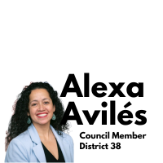
OUR CONCERNS WITH CITY OF YES
ZONING FOR ECONOMIC OPPORTUNITY
NOTE: This is a public awareness document and does not constitute an endorsement of any of the text amendments included in City of Yes.
Created by the Office of Council Member Alexa Avilés March 2024

Slide 2
A QUICK NOTE ON CITY OF YES
While we agree with the overall goals of the ZEO to allow local businesses the space to change and grow, here are a few pieces we are working in coalition to address. For more on the City of Yes proposal, visit our website.

Slide 3
The Industrial Business Zone (IBZ) in District 38.
SUNSET PARK
HOOK
MANUFACTURING ZONES

Slide 4
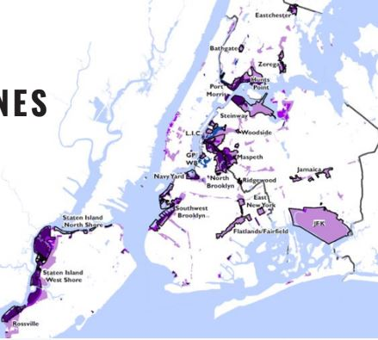
CITYWIDE IBZs
Created in 2005, Industrial Business Zones (IBZs) were most recently updated in 2013 by an EDC Commission
The mission of IBZs is to preserve industrial, but with no formal commitment
8% of NYC is an IBZ
57% of all M-Zones are in IBZs
62% of M districts are M1

Slide 5
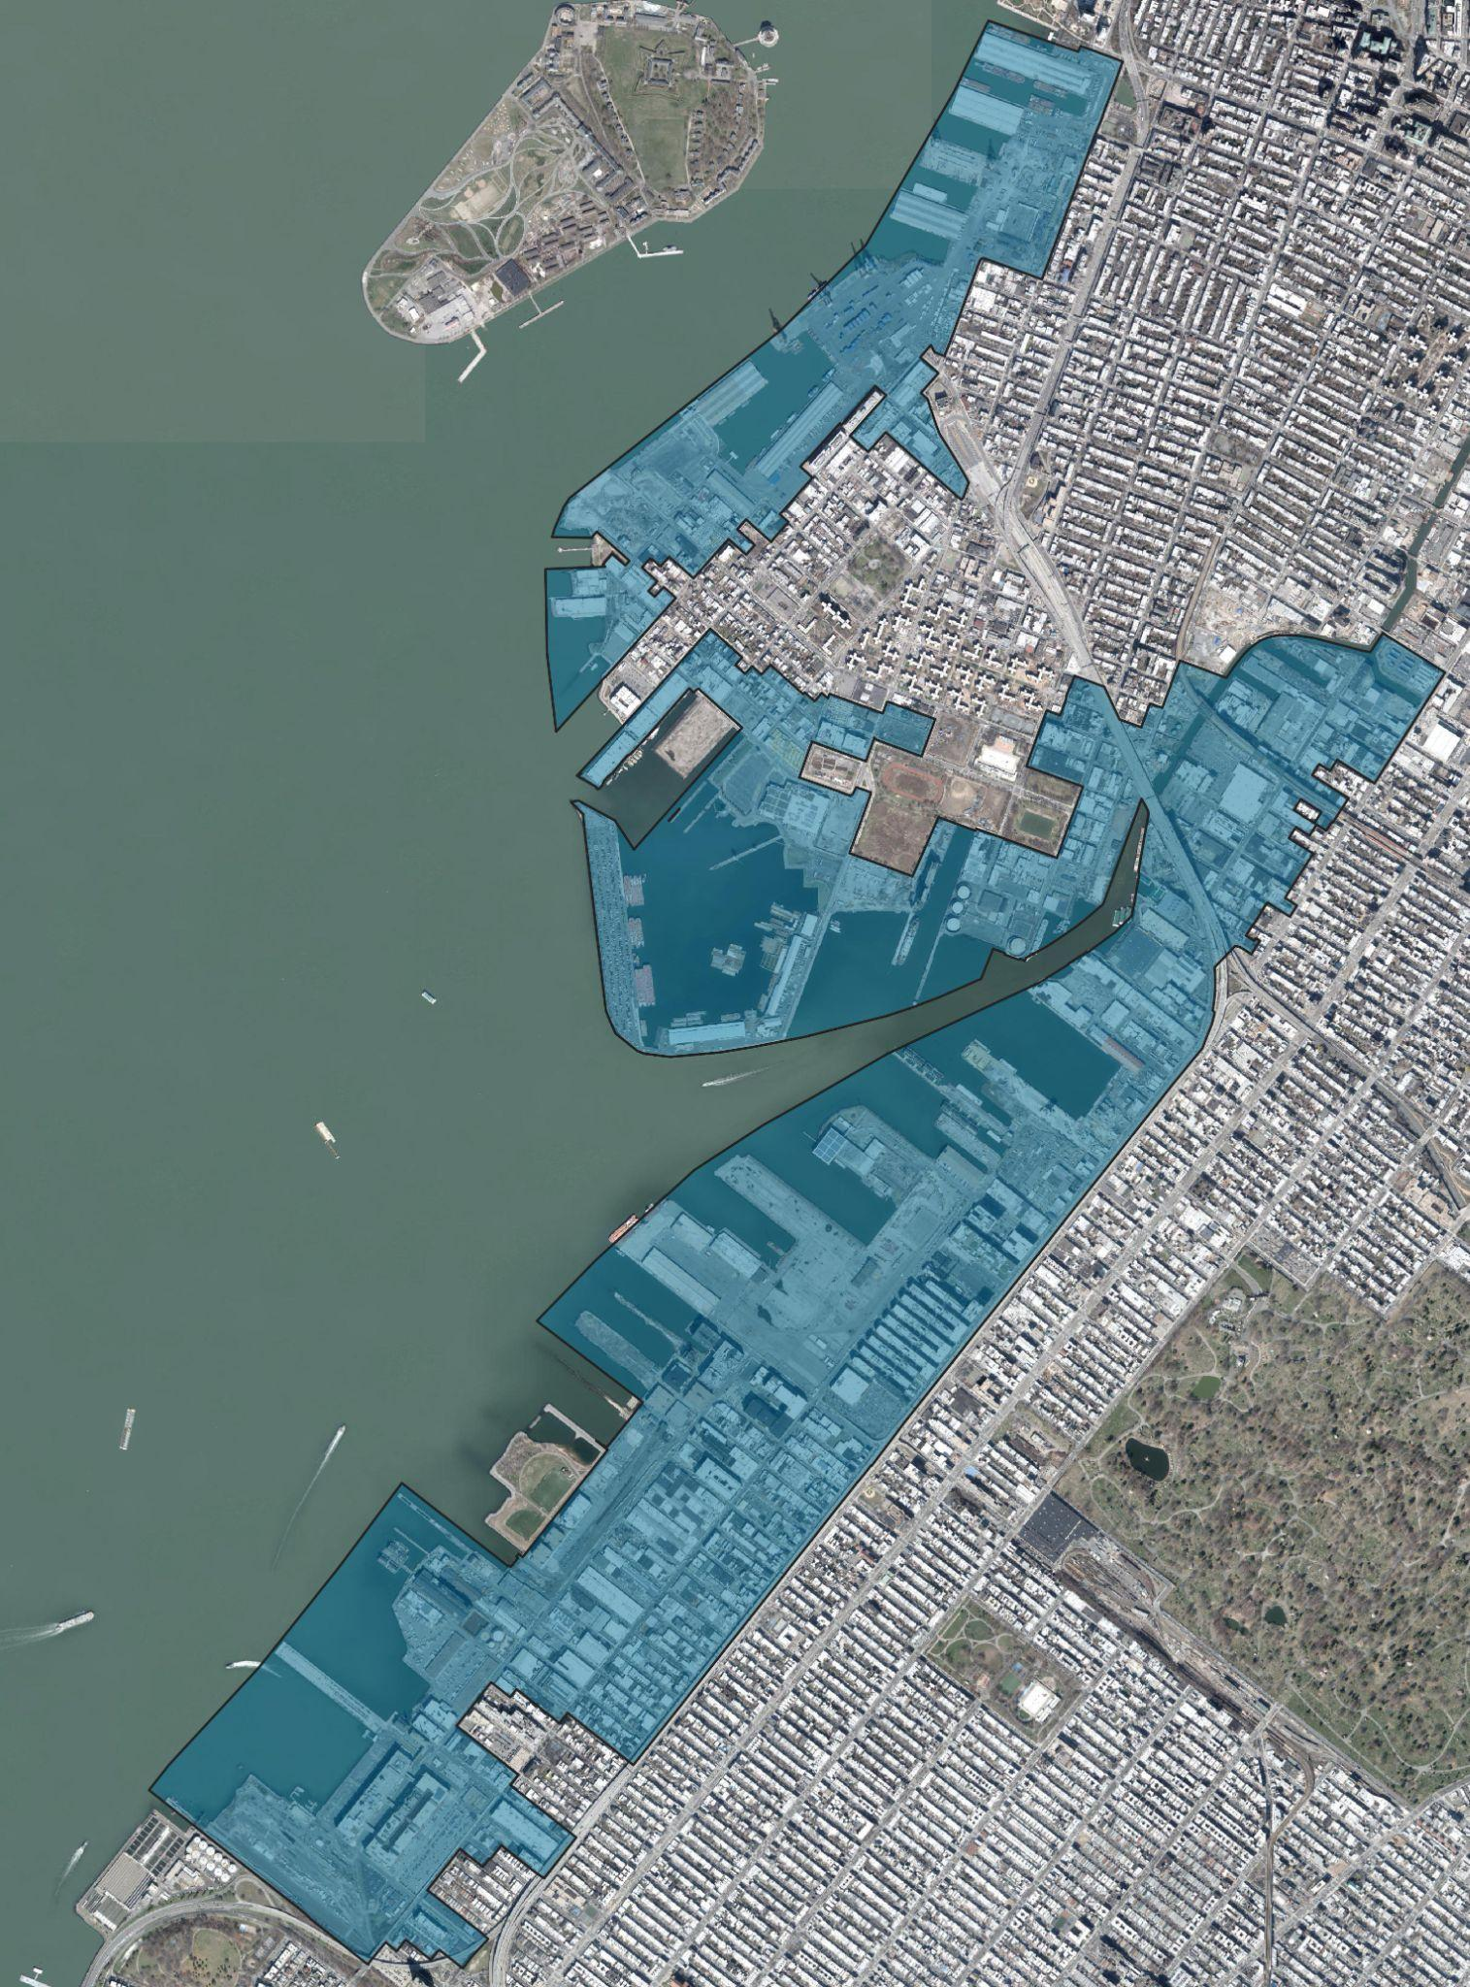
IBZs AND DISTRICT 38
RED HOOK
Through the work of a robust coalition of elected officials in city government, we have entered into conversations with DCP regarding some of our concerns with current zoning in our IBZ.
As you know, Sunset and Red Hook have significant IBZs. Over 1 out of 5 of our district neighbors works in the industrial sector (i.e. construction, manufacturing, wholesale trade, transportation & warehousing, utilities)
For more on our district profile, read the data snapshot report on our website.
SUNSET PARK
The Industrial Business Zone (IBZ) in District 38.

Slide 6
GOOD JOBS
Our IBZs are critical to our neighborhood and our city.
NYC’s over 500,000 industrial jobs provide accessible career pathways for New Yorkers without a college degree, and non-native English speakers with higher wages and more opportunities for advancement than hospitality, retail, and other sectors.
80% of the workforce is made up of people of color.

Slide 7
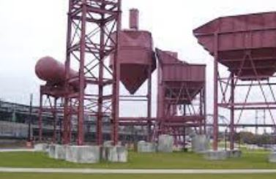
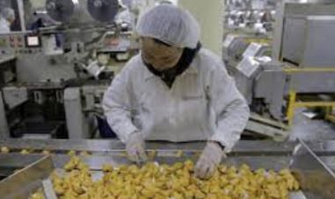
ESSENTIAL SERVICES + OPERATIONS
Recycling + waste transfer stations
Concrete + asphalt plants
Aggregate recycling
Wastewater treatment
Lumber treatment
SUNSET PARK
The Industrial Business Zone (IBZ) in District 38.
Metal fabrication
Food distribution
Construction equipment storage
Bus + truck depots
Power plants + fuel storage
NYC relies on industrial business and operations to keep our city running every day. Industrial uses include:

Slide 8
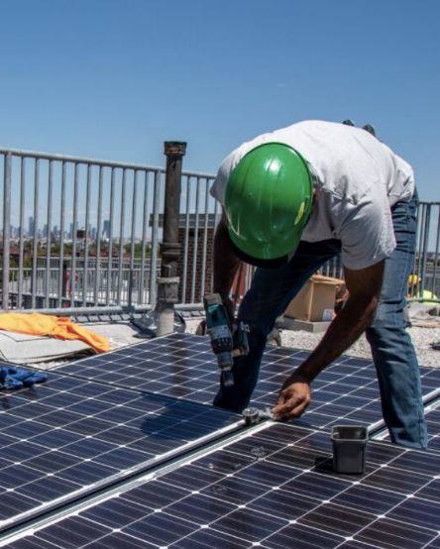
GREEN ECONOMY
Help us reach our climate goals and become a regional hub for the green economy.
Manufacturing for offshore wind, solar power businesses, and battery storage for clean energy.
Sustainable and alternative freight movement, including maritime, rail transfer stations, charging stations for electric trucks.
“Green” building design and construction services needed to upgrade NYC buildings to new GHG emissions standards.

Slide 9
CURRENT THREATS TO M-ZONES INCLUDE:
Market pressure leads to proliferation of nightlife, office + commercial uses
Absence of appropriate zoning districts to facilitate industrial business growth and investments
Loss of critical industrial sites (esp near waterfront) to commercial uses
Lack of distinction between areas needed for heavy industry/ infrastructure vs. mixed use
Lack of middle density districts (3, 4 FAR) with archaic parking and loading requirements

Slide 10
WE AIM TO:
Create three new industrial zoning districts as a part of negotiations on the ZEO text amendment. They would include:
Core Industrial District
Mixed/ Transition District
Growth District
SUNSET PARK
The Industrial Business Zone (IBZ) in District 38.

Slide 11
LINKS TO RESOURCES
CITY OF YES WEBSITE
ECONOMIC OPPORTUNITY TEXT AMENDMENT WEBSITE
TIMELINE CREATED BY THE OFFICE OF COUNCIL MEMBER ALEXA AVILÉS

